Slide 1



US Accidents Analysis
Cairo university Faculty of engineering Computer engineering department Big Data [CMP4011] Project presentation
Technical Part
Presented to
Eng.Omar Samir

Slide 2
Team 14
Ahmed asaad darwish mohamed | 1 | 1
Mamdouh ahmed Mohamed attia | 2 | 26
Omar fareed Abdel-Aaty | 2 | 6
Mohamed Nabil Abd-Alfattah | 2 | 19

Slide 3
01 Data Acquisition & Preprocessing
04 Results and Evaluation
02 Exploratory Data Analysis (EDA)
05 Cloud journey
03 Machine Learning Models
06 Challenges faced
lessons learnt
Future work

Slide 4
01 Data preprocessing

Slide 5
1. Data preprocessing steps:
a. Get null counts for each row
Count null values for each column
Calculate total row count
Subtract non-null counts from total row count to get null counts for each column
Display null value counts for each column
Drop nulls
b. Calculate missing value percentages for each column
Filter out columns with non-zero null value percentages

Slide 6
02 EDA [Expletory data analysis]

Slide 7
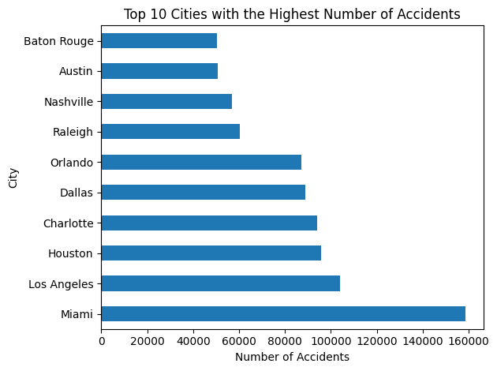
Explore city column
Show the first few rows of the 'City' column
Count the number of unique cities in the 'City' column
Number of unique cities: 11729
Group the data by 'City' and count the number of occurrences
Sort the result in descending order based on the accident counts
Get the city with the highest number of accidents
City with the highest number of accidents: Miami
Number of accidents in Miami: 158736
Plot the first 10 cities with the highest number of accidents

Slide 8
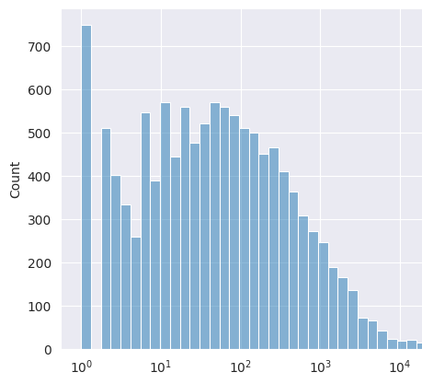
Plot a histogram of number of accidents :
From the graph we can analyze that distribution of accident is more between ten to hundred. When it goes further its decreasing exponentially.

Slide 9
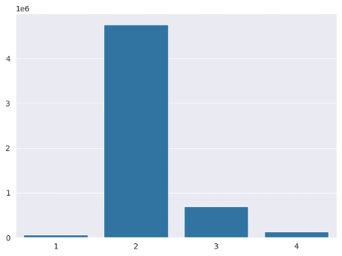
b. Severity column analysis & preprocessing
Convert the Severity to integer
Group data by severity
Sort the result in descending order based on the severity counts
Get the Severity with the highest number of accidents
Severity with the highest accidents count: 2
Where the Number of accidents of severity degree: 4756722
Plot the severity class frequency:
From the graph we conclude that the class of severity = 2 is the most frequent class.

Slide 10
c. Start Time analysis
Convert "Start_Time" and "End_Time" columns to datetime format
Hour, day/week , month, year:
Extract each in a separate column

Slide 11
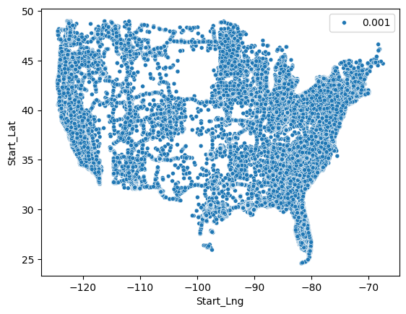
d. Start latitude & longitude
We plot a scatter plot to distribute the locations of accidents geographically:

Slide 12
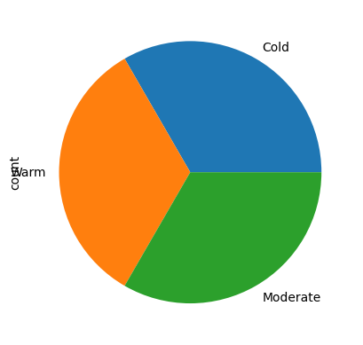
e.Analyzing weather columns
Analyzing weather columns:
1.Are there more accidents in warmer or colder areas?
Define temperature bins and labels
Use 'when' function to assign temperature categories based on the bins
Add the temperature category column to the DataFrame
Group by temperature category and count the number of accidents
Results
+--------------------+---------+
|Temperature_Category|Accidents|
+--------------------+---------+
| Cold| 1800430|
| Warm| 1393745|
| Moderate| 2462664|
+--------------------+---------+

Slide 13
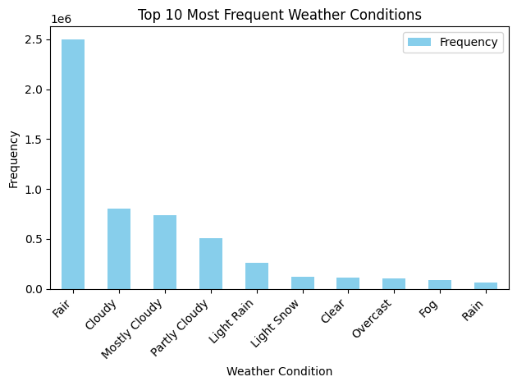
e.ii:Frequency of Weather Conditions
Group by weather condition and count the frequency of each condition
Get top 10 most frequent weather conditions:

Slide 14
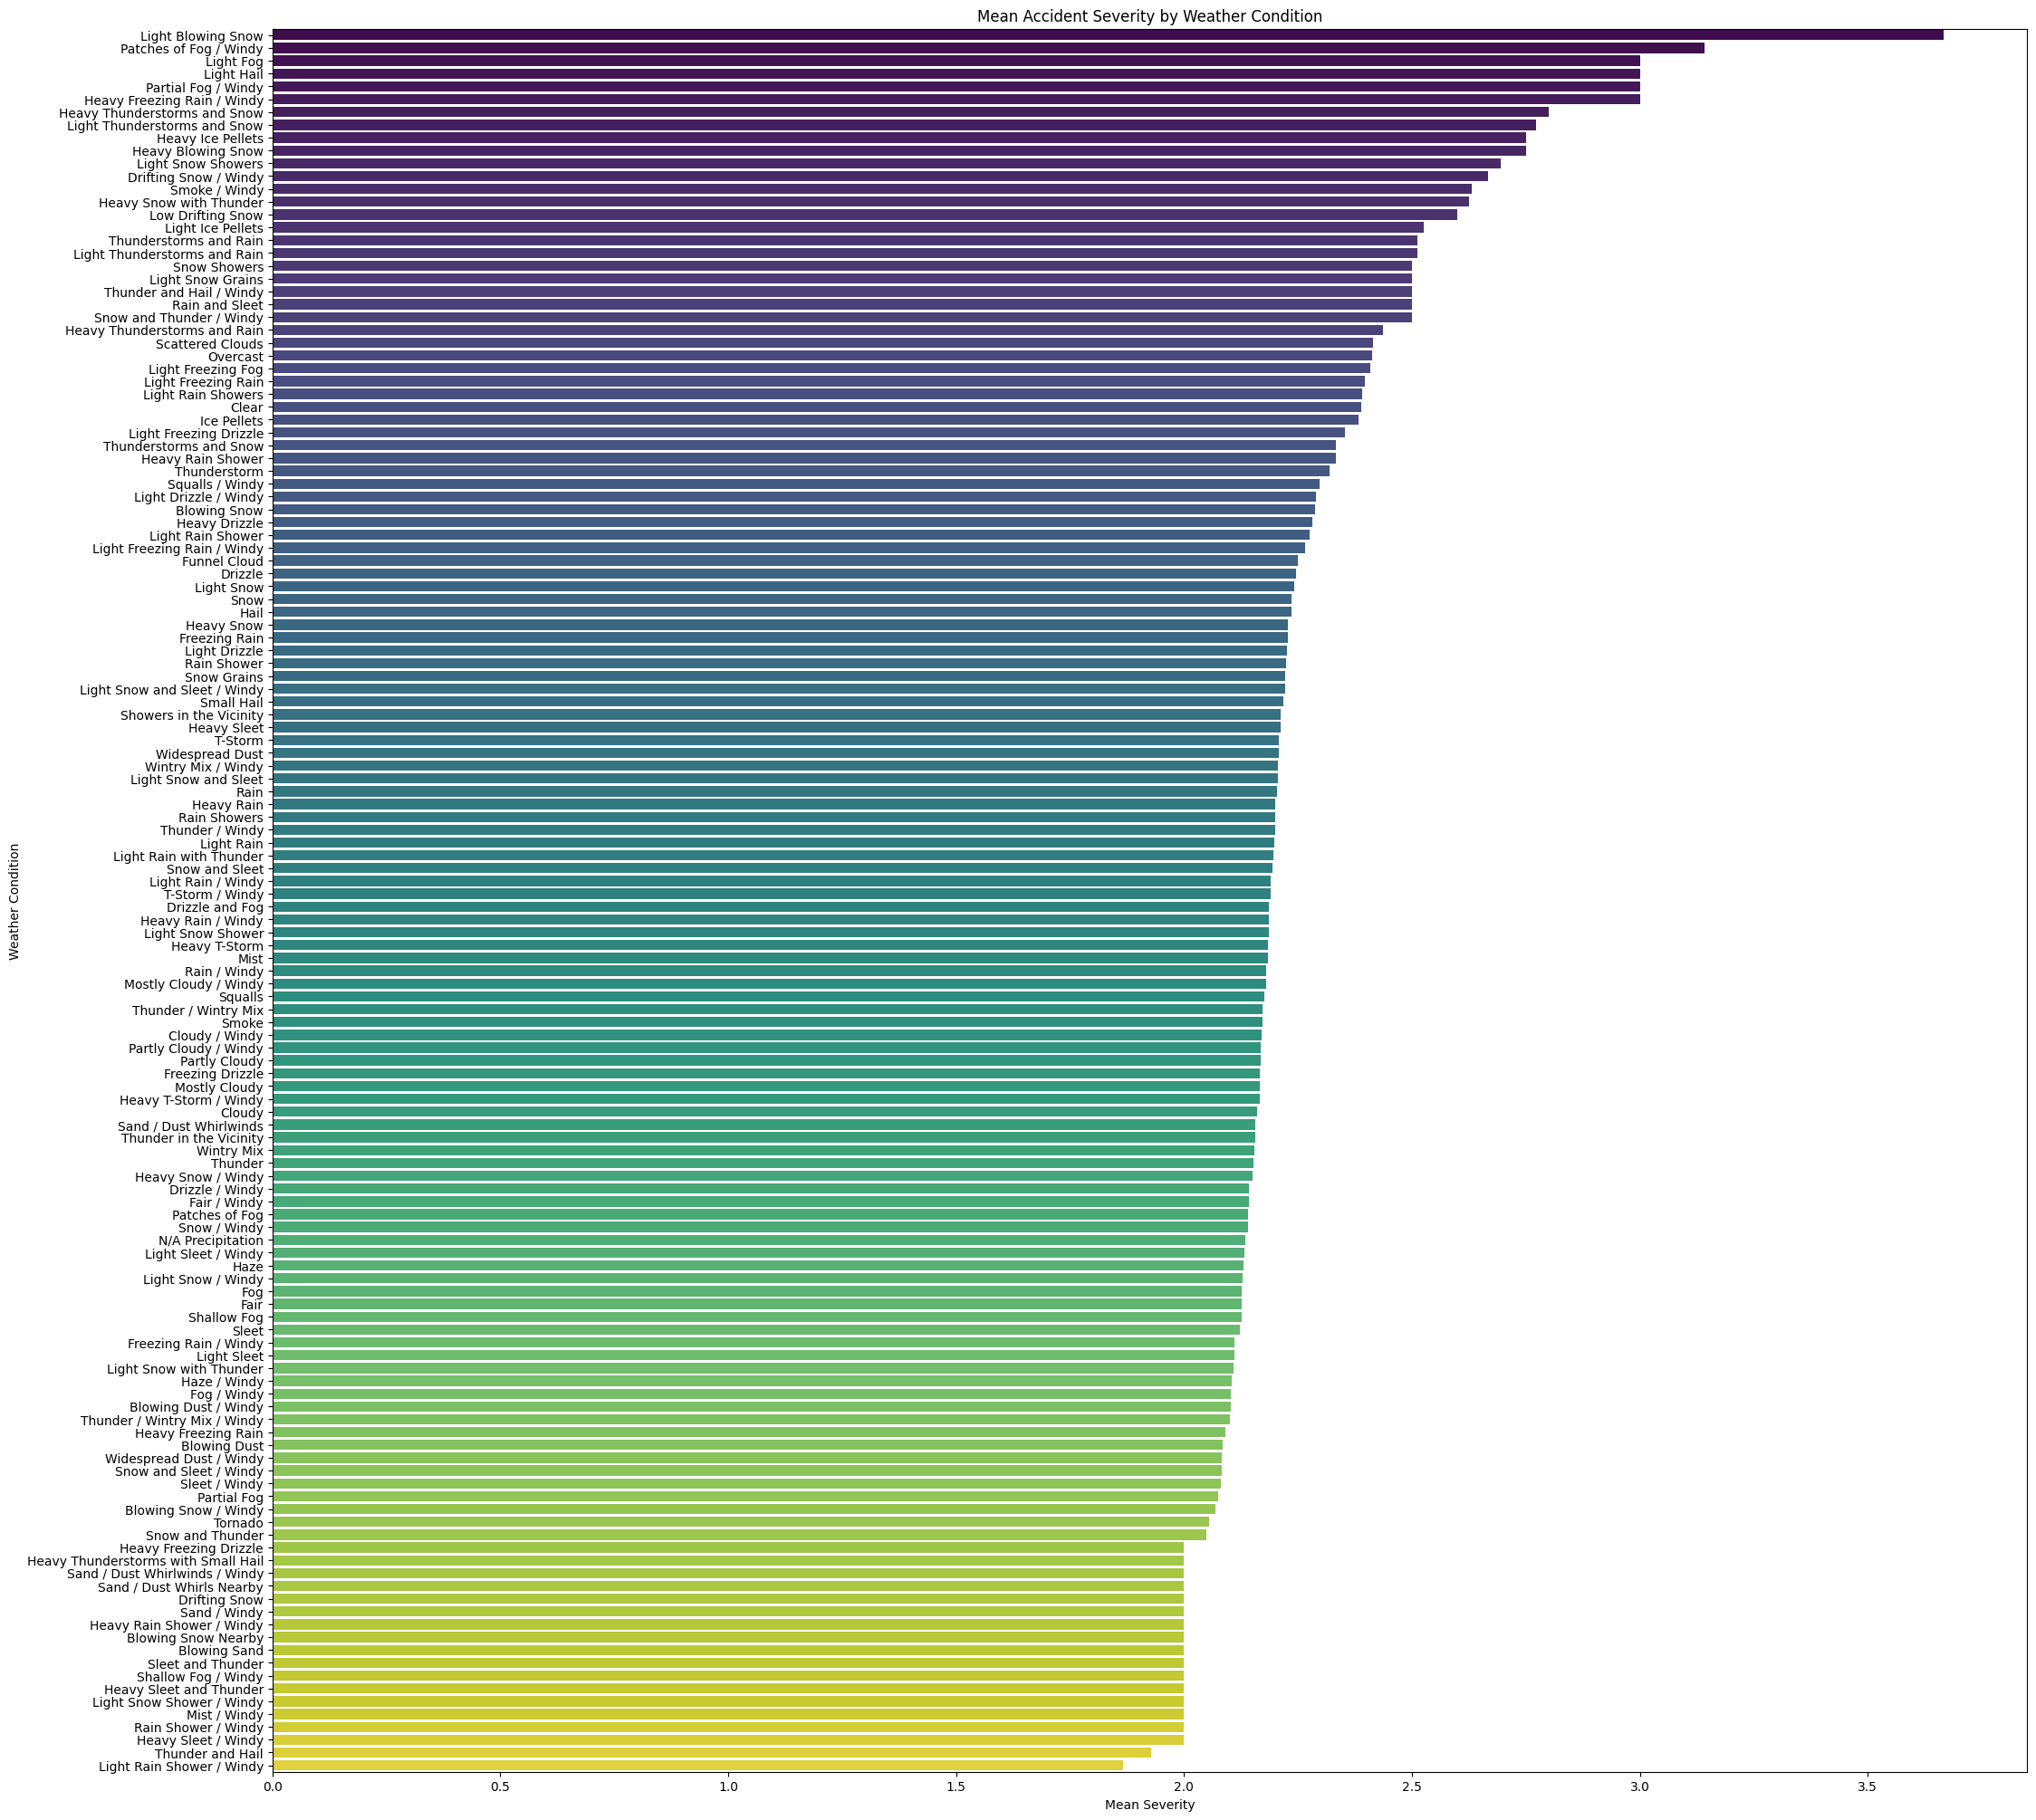
Cont’d:
Impact of Weather on Accident Severity
Group data by weather condition and calculate mean severity
Plot the values:

Slide 15

Analysis
Light blowing snow is a weather condition characterized by light snowfall accompanied by strong winds that cause the snow to be lifted from the ground and blown around. This weather condition can significantly reduce visibility and create hazardous driving conditions. Overall, it poses significant hazards to drivers and can contribute to the severity of accidents by reducing visibility, creating slippery road conditions, and increasing the likelihood of collisions.

Slide 16
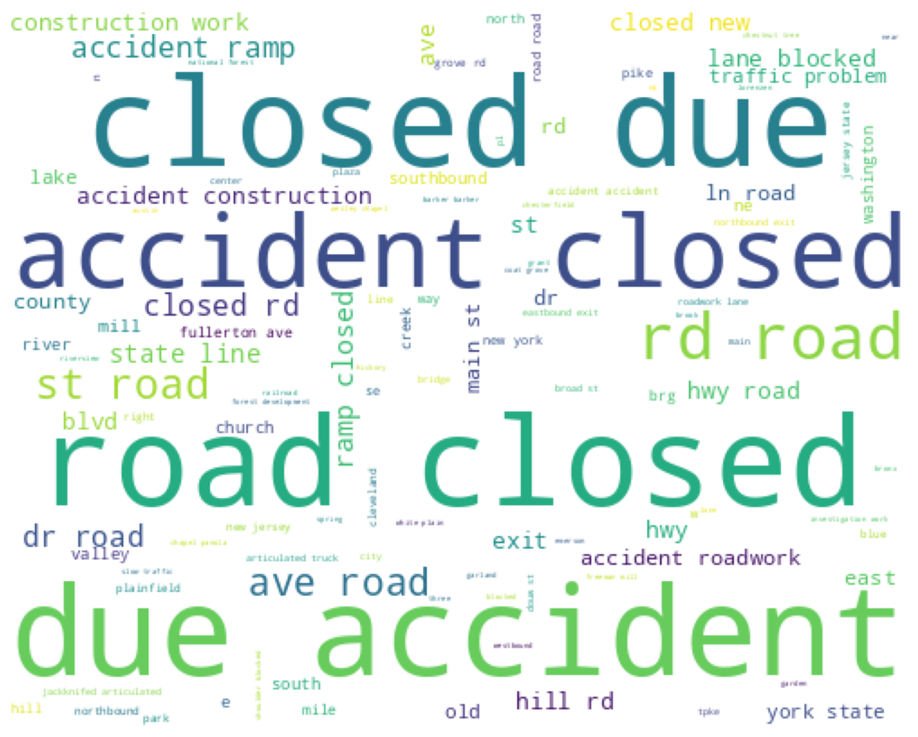
f. Word cloud of ‘description’

Slide 17
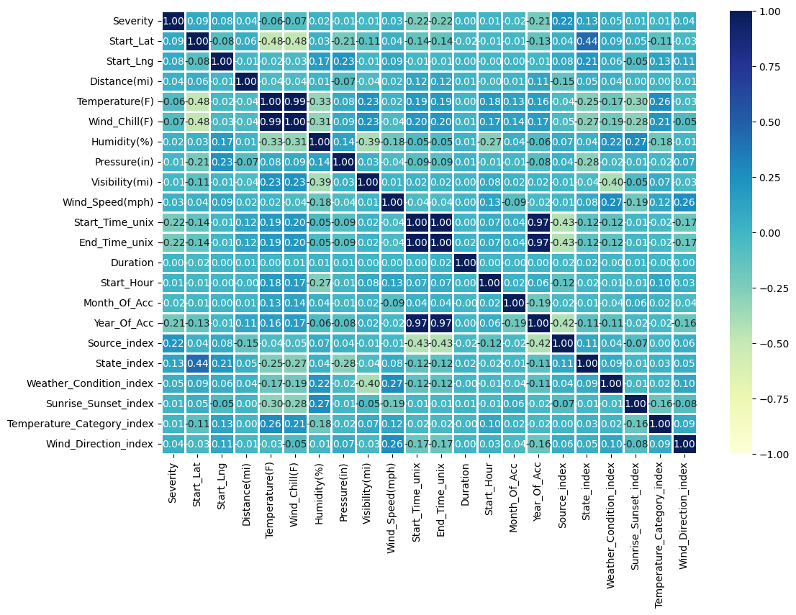
g. Correlation matrix

Slide 18
03 Machine Learning Models

Slide 19
For more details please refer to the report

Slide 20
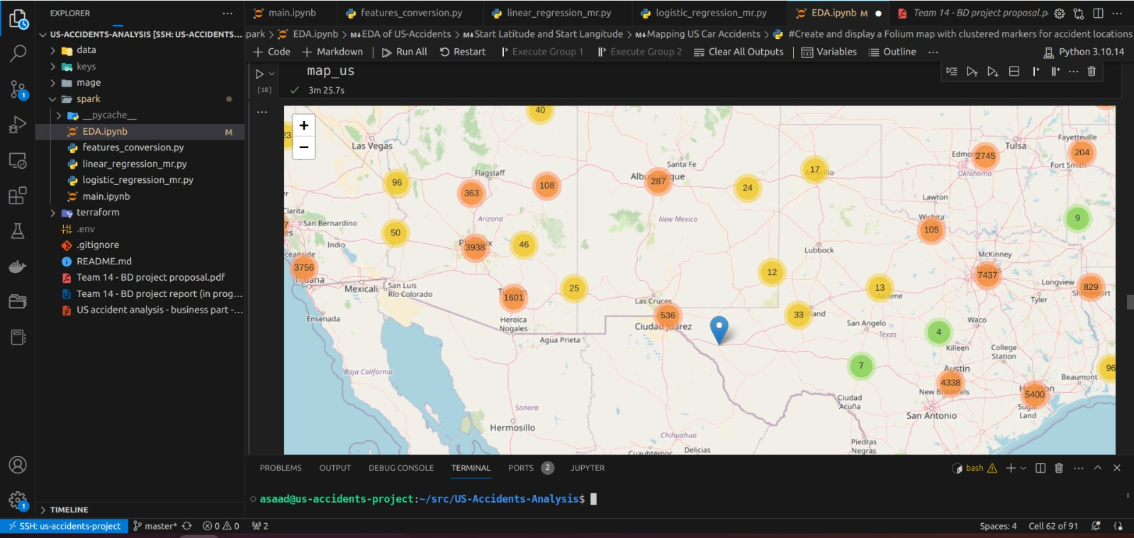

Slide 21
04 Results and Evaluation

Slide 22
Results summary
Model | Accuracy | F1 – Score
Logistic regression [ Ready made ] | 0.8408217891358007 | 0.7685677937765466
Logistic regression [ Student made] | Errors occurred we didn't manage to solve on time
Random Forest | 0.8406899831395097 | 0.7680208605030131
Naïve Bayes | 0.0114178970079841 | 0.0002577932869698

Slide 23
05 Cloud Journey

Slide 24
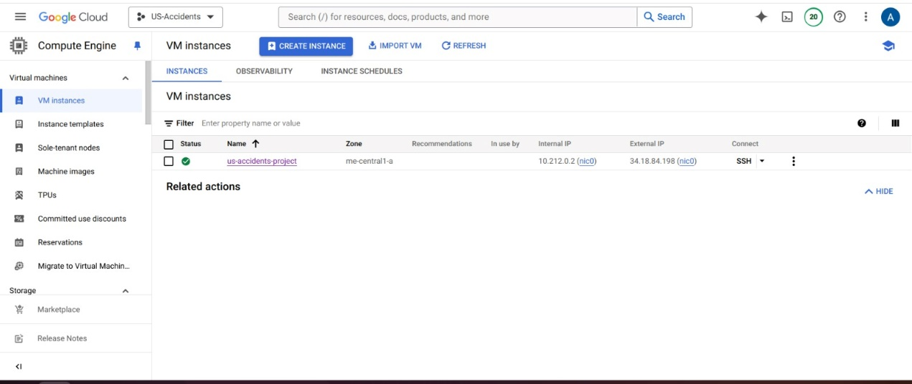

Slide 25
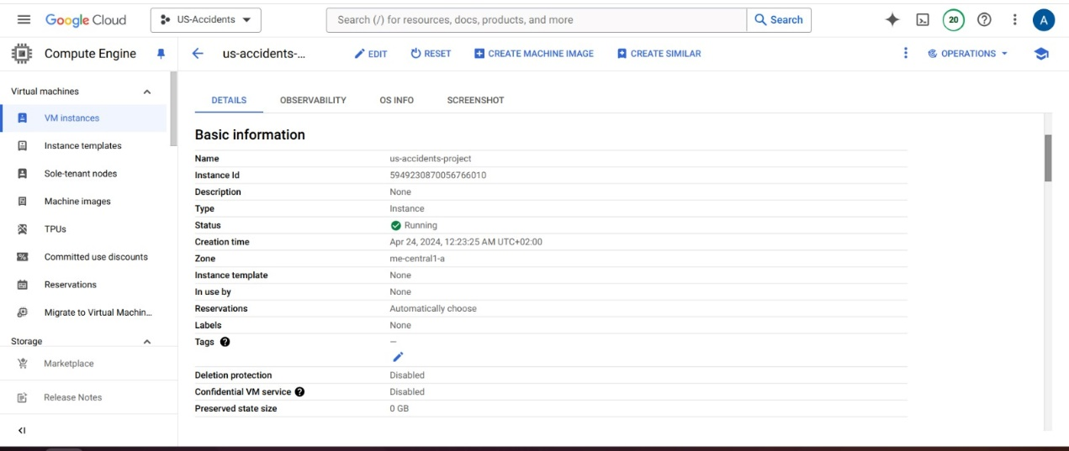
Used terraform as IAC (infrastructure as Code)➔ to create our resources on GCS

Slide 26
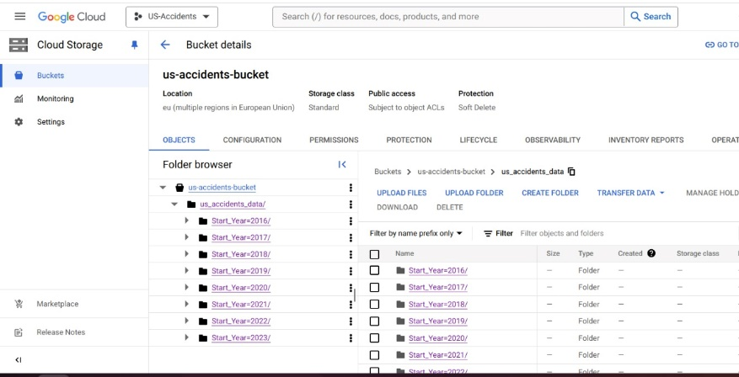

Slide 27
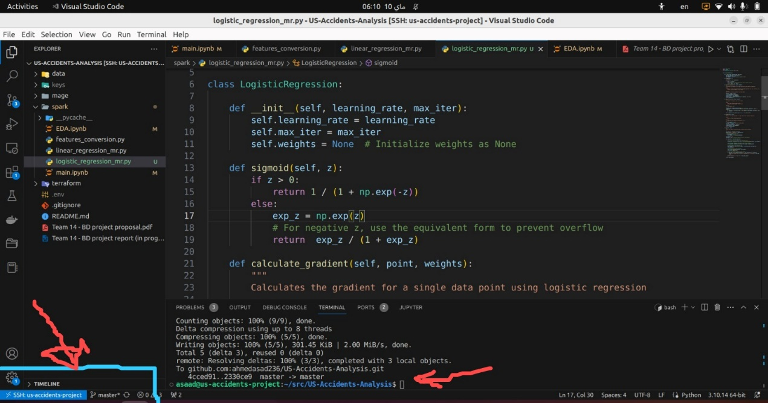

Slide 28
Cloud details
We used a remote VM and accessed it through VScode SSH connection
Use Mage for data pipeline Orchestration:
- Load the data from local after downloading from Kaggle
- Apply some cleaning and column removing
- Partition the data into 7 parquet files and export them to GCS (Google Cloud Storage)

Slide 29
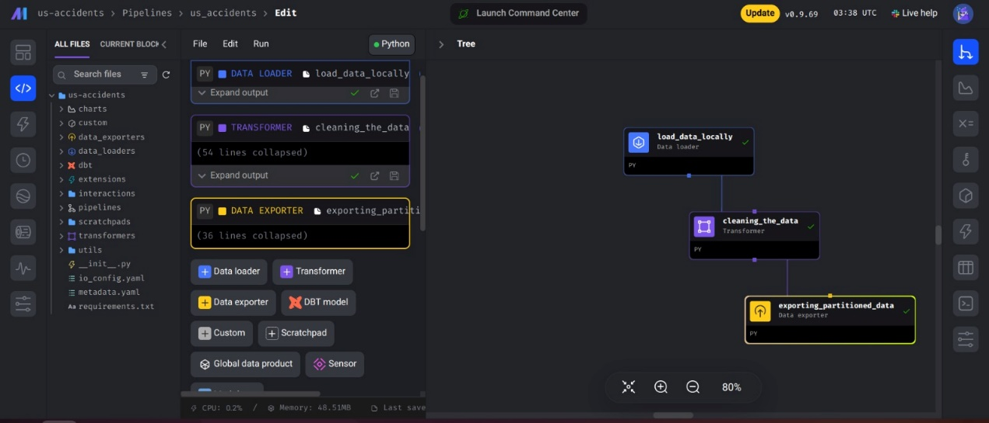

Slide 30
Thank You !
End of Technical Part

